Slide 1
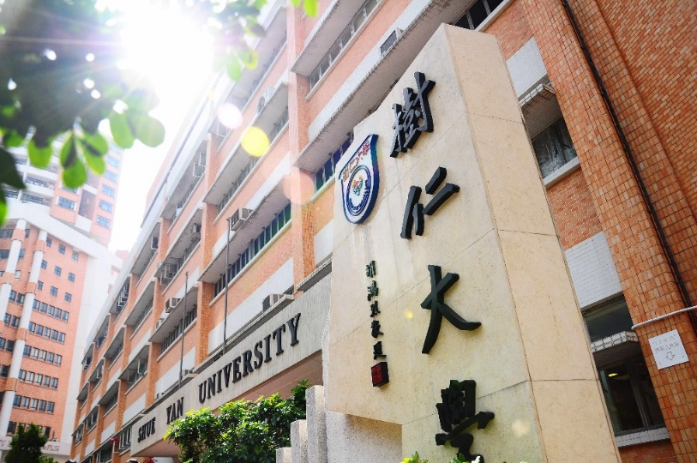
2023-24 年度
二年級入學(Year 2 entry)同學
修科指引
入學後三年內共修91學分畢業

Slide 2
 |  |  | Credits
Compulsory Courses:
Language Requirements: |  |  | 10
CHI. | 102 | First Year Chinese (including Practical Chinese Writing)
ENG. | 211-2 | English Writing
Departmental Core Requirements: |  |  | 12
SOC. | 205 | Sociological Theory I
SOC. | 207 | Sociological Theory II
SOC. SOC. OR SOC. | 221 221A 221B | Social Research Methods Applied Quantitative Social Research Methods Applied Qualitative Social Research Methods
Departmental Elective Courses* (Choose 9 credits) |  |  | 9
SOC. | 204 | Cultures in the Contemporary World
SOC. | 206 | Social Stratification
SOC. | 231 | Social Problems
SOC. | 257 | Art and Society
SOC. | 259 | Race and Ethnicity
SOC. | 260 | Food and Society
SOC. | 261 | Conceptualising Arts and Culture in Modernity
Free Elective |  |  | 6
Total Minimum Credits |  |  | 37
*The Departmental Elective Courses offered might be subjected to change.

